Slide 1
TRIOT Solutions
NAME: APEKSHA JITENDRA GHADAGE
DOMAIN: WEB DEVELOPMENT

Slide 2
About me:
My name is Apeksha Jitendra Ghadage. During my third year of computer studies, I honed my skills as a web developer through the TRIOT internship, completing three tasks. This experience enriched my knowledge, enhanced my logical thinking abilities, and allowed me to identify and address my weaknesses in the field. It provided me with valuable opportunities for growth and development in web development.

Slide 3
Internship Objective:
Gain practical experience in web development.
Enhance skills in coding and designing websites.
Learn about industry standards and best practices.
Identify and address areas for improvement in skills and knowledge.

Slide 4
Skills Development:
Technical Skills:
Improved proficiency in scripting languages.
Developed expertise in web development tools and technologies.
Logical Thinking:
Strengthened logical thinking abilities through problem-solving tasks.
Applied logical reasoning to tackle complex coding challenges.
Problem-Solving:
Developed strategies to troubleshoot and resolve technical issues.
Applied analytical skills to identify and address challenges in web development projects.

Slide 5
Challenges and Problem solving:
During the internship, I encountered challenges with visualizing webpages and implementing them in code. Although I didn't completely overcome this obstacle, I actively sought solutions. I utilized resources such as YouTube tutorials, Google searches, and even consulted with ChatGPT. These efforts helped me make progress in addressing this particular challenge and contributed to my ongoing learning and development in web development.

Slide 6
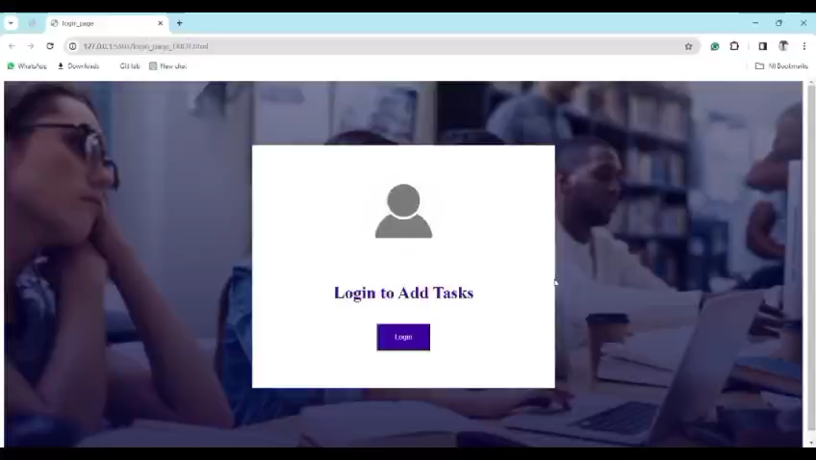
Project Presentation:

Slide 7

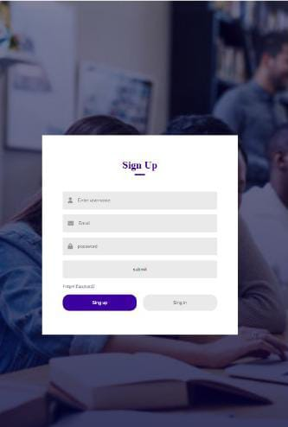


Slide 8

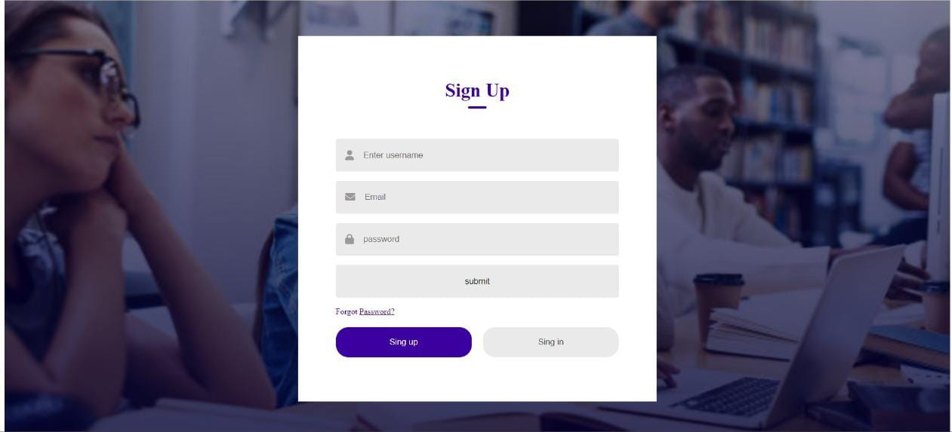
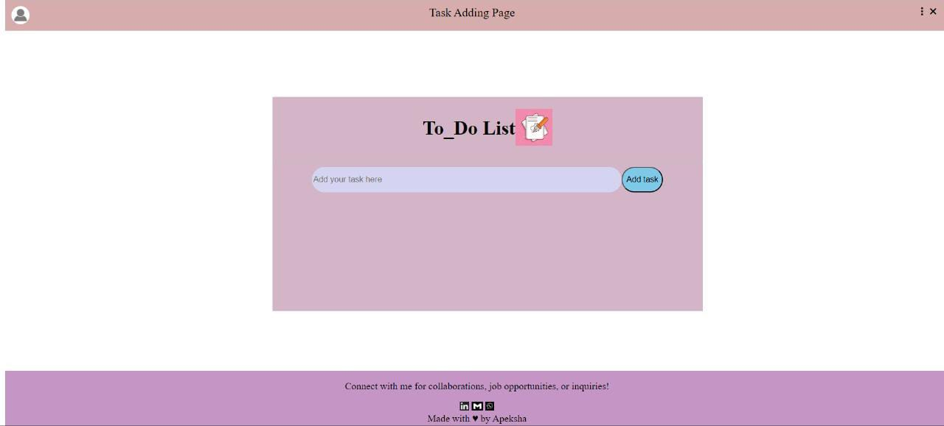

Slide 9
QUESTIONS & ANSWERS

Slide 10
THANK YOU!

